Slide 1
CS 6360: Advanced Artificial Intelligence Lecture 7 MCTS: UCT algorithm + Game of Hex
Gautam Biswas
Spring 2017

Slide 2
Outline of Lecture
Monte Carlo Tree Search
General MCTS algorithm
Picking winning moves
Extending MCTS
UCT – upper confidence bound for trees
Balancing exploitation and exploration
Characteristics of MCTS
Assignment 2
Game of Hex

Slide 3
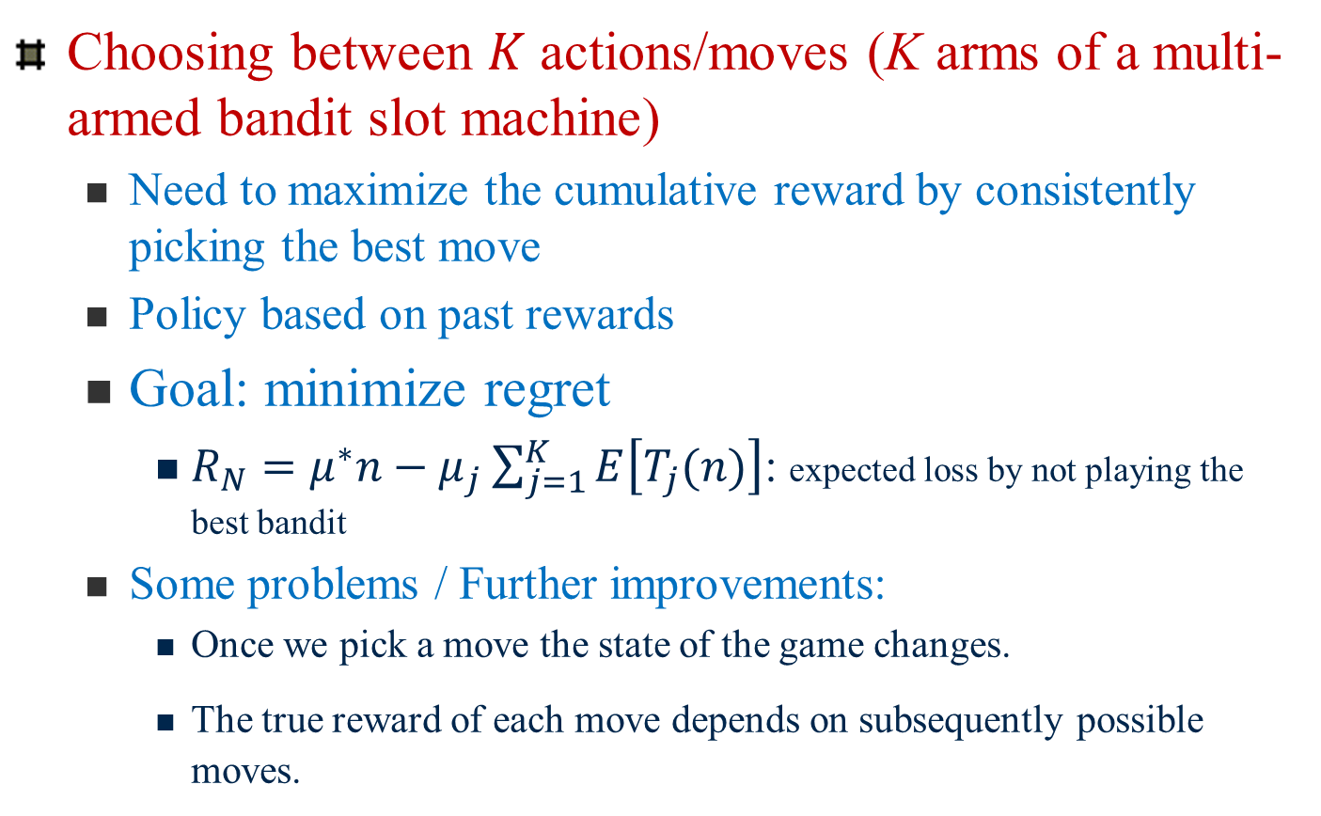
Bandit-Based Methods
Choosing between $K$ actions/moves (K arms of a multi-armed bandit slot machine)
Need to maximize the cumulative reward by consistently picking the best move
Policy based on past rewards
Goal: minimize regret
$R_{N}=μ^{∗}n−μ_{j}\sum_{j=1}^{K}{E\left[T_{j}(n)\right]}$: expected loss by not playing the best bandit
Some problems / Further improvements:
Once we pick a move the state of the game changes.
The true reward of each move depends on subsequently possible moves.

Slide 4
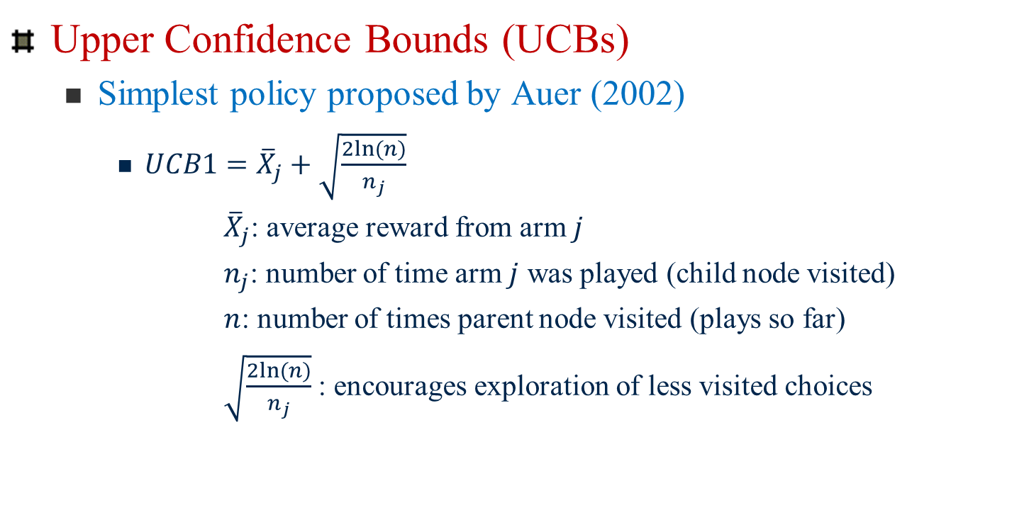
Bandit-based Methods
Upper Confidence Bounds (UCBs)
Simplest policy proposed by Auer (2002)
$UCB1={\overline{X}}_{j}+\sqrt{\frac{2ln⁡(n)}{n_{j}}}$
${\overline{X}}_{j}$: average reward from arm $j$
$n_{j}$: number of time arm $j$ was played (child node visited)
$n$: number of times parent node visited (plays so far)
$\sqrt{\frac{2ln⁡(n)}{n_{j}}}$ : encourages exploration of less visited choices
Balance between exploration and exploitation
Basis for UCT

Slide 5
MCTS -- overview
Two Fundamental Concepts:
The true value of any action can be approximated by running several random simulations.
These values can be efficiently used to adjust the policy (strategy) towards a best-first strategy
Builds a partial game tree before each move. Then selection is made.
Moves are explored and values are updated/estimated.

Slide 6
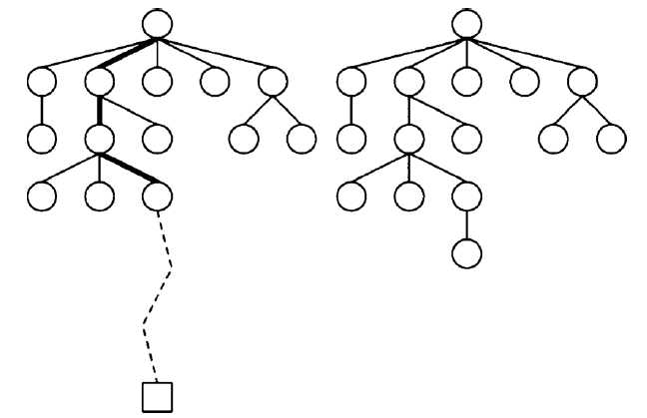
Basic MCTS process
Iteratively build partial search tree
Iteration
Most urgent node
Tree policy
Exploration/exploitation
Simulation
Add child node
Default policy
Update weights
Exploitation
(look in areas that appear to be promising)
Exploration
(look in areas not well-sampled yet)
Values of intermediate states do not have to be updated
Requires less domain knowledge

Slide 7
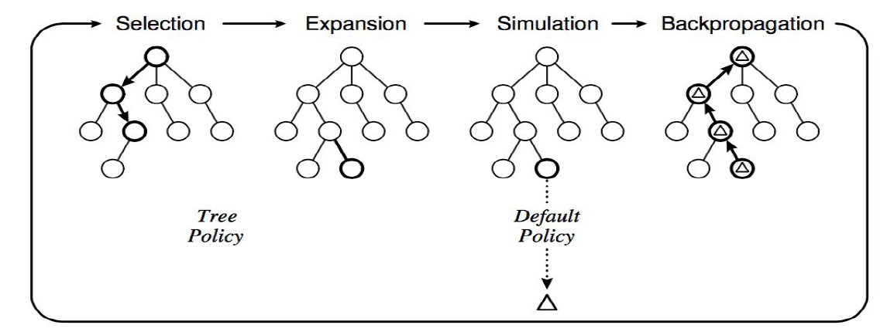
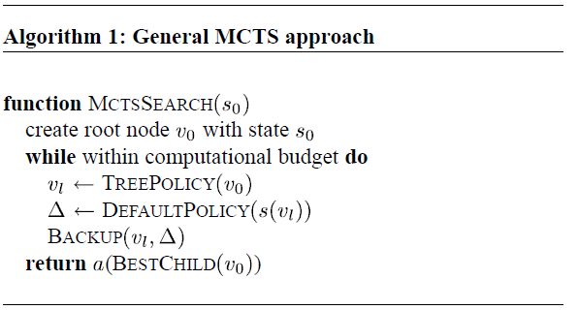





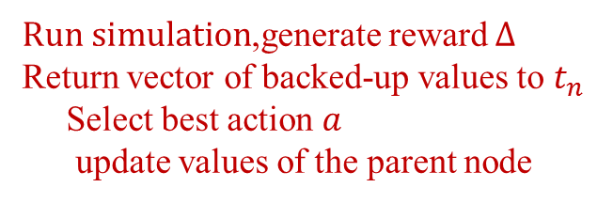


MCTS Algorithm
$$t_{0}$$
$$t_{n}$$
$$t_{n}$$
$$t_{l}$$
$For each node, store$
reward value, number of visits
$t_{0}$ to $t_{n}$ : choose using utility fn
${apply action a: t}_{n}$ to $t_{l}$ (expansion)
$Run simulation$,generate reward $Δ$
Return vector of backed-up values to $t_{n}$
Select best action $a$
update values of the parent node

Slide 8
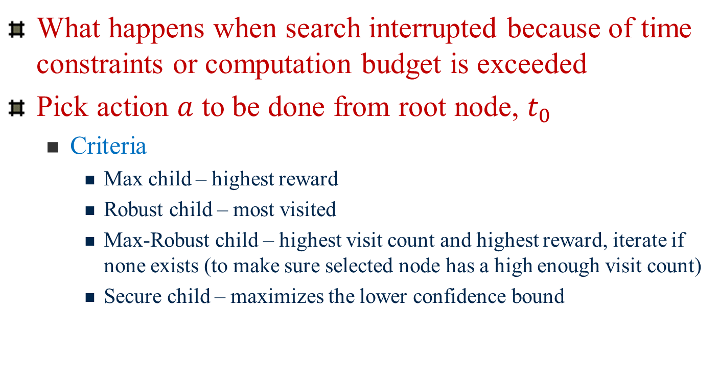
MCTS algorithm
What happens when search interrupted because of time constraints or computation budget is exceeded
Pick action $a$ to be done from root node, $t_{0}$
Criteria
Max child – highest reward
Robust child – most visited
Max-Robust child – highest visit count and highest reward, iterate if none exists (to make sure selected node has a high enough visit count)
Secure child – maximizes the lower confidence bound

Slide 9
MCTS – advances
Kocsis and Szepesvári, 2006
Formally describing bandit-based method
Simulate to approximate reward
MCTS has small error probability, even when stopped prematurely
Proved MCTS converges to minimax solution given sufficient time
UCB1: finds optimal arm of upper confidence bound (UCT employed UCB1 algorithm on each explored node)
As discussed, balance of exploitation and exploration

Slide 10
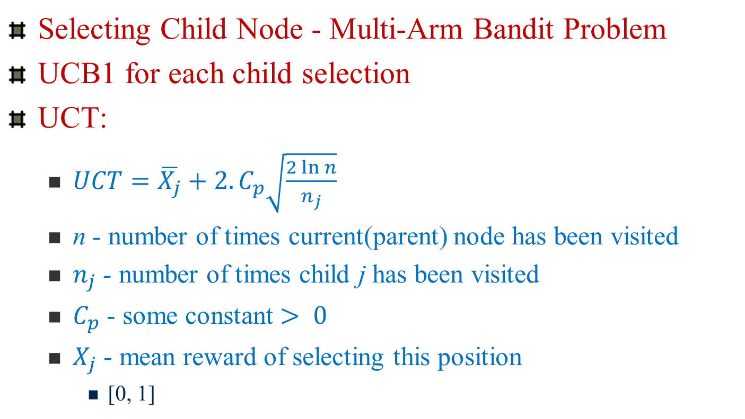
UCT Algorithm
Selecting Child Node - Multi-Arm Bandit Problem
UCB1 for each child selection
UCT:
$UCT=\overline{X_{j}}+2.C_{p}\sqrt{\frac{2\ln{n}}{n_{j}}}$
n - number of times current(parent) node has been visited
$n_{j}$ - number of times child j has been visited
$C_{p}$ - some constant $> 0$
$X_{j}$ - mean reward of selecting this position
[0, 1]

Slide 11
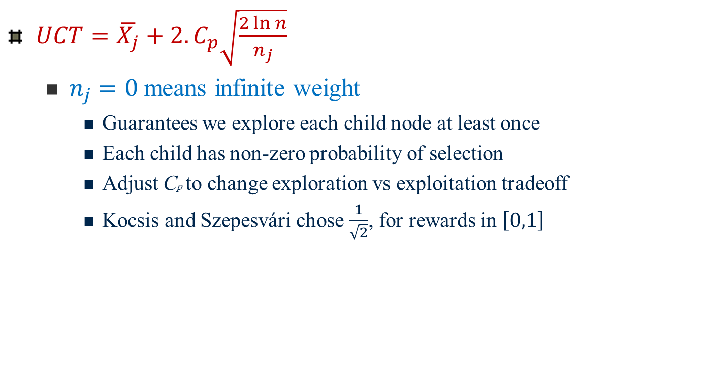
UCT algorithm
$UCT=\overline{X_{j}}+2.C_{p}\sqrt{\frac{2\ln{n}}{n_{j}}}$
$n_{j}=0$means infinite weight
Guarantees we explore each child node at least once
Each child has non-zero probability of selection
Adjust Cp to change exploration vs exploitation tradeoff
Kocsis and Szepesvári chose $\frac{1}{\sqrt{2}}$, for rewards in $\left[0,1\right]$

Slide 12
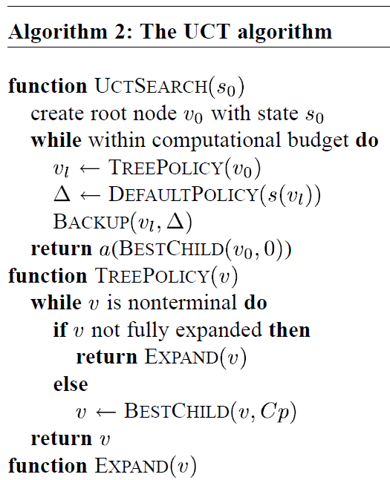
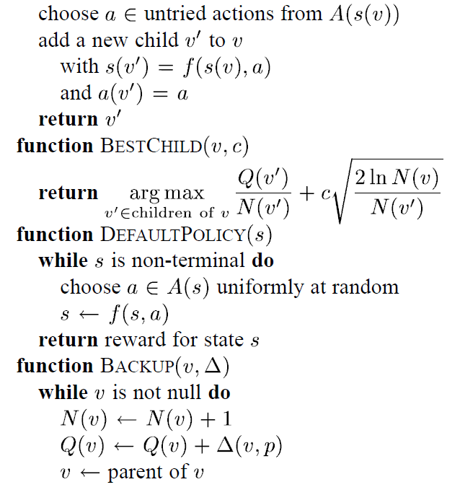
UCT Algorithm

Slide 13
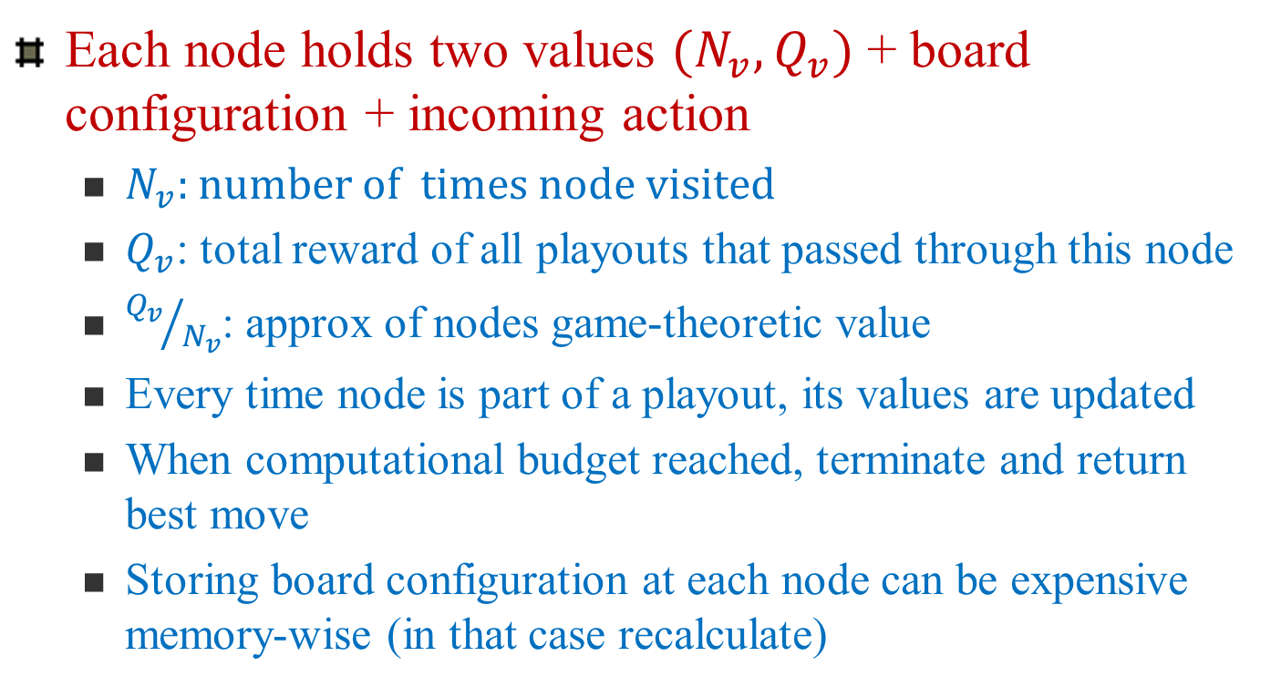
UCT algorithm
Each node holds two values $(N_{v},Q_{v})$ + board configuration + incoming action
$N_{v}:$number of times node visited
$Q_{v}$: total reward of all playouts that passed through this node
${Q_{v}}/{N_{v}}$: approx of nodes game-theoretic value
Every time node is part of a playout, its values are updated
When computational budget reached, terminate and return best move
Storing board configuration at each node can be expensive memory-wise (in that case recalculate)

Slide 14
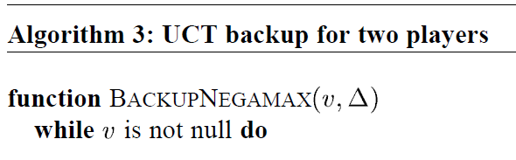
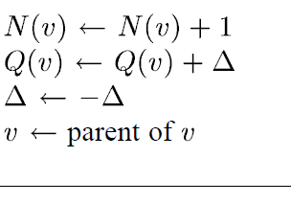
UCT Algorithm: Two player games

Slide 15
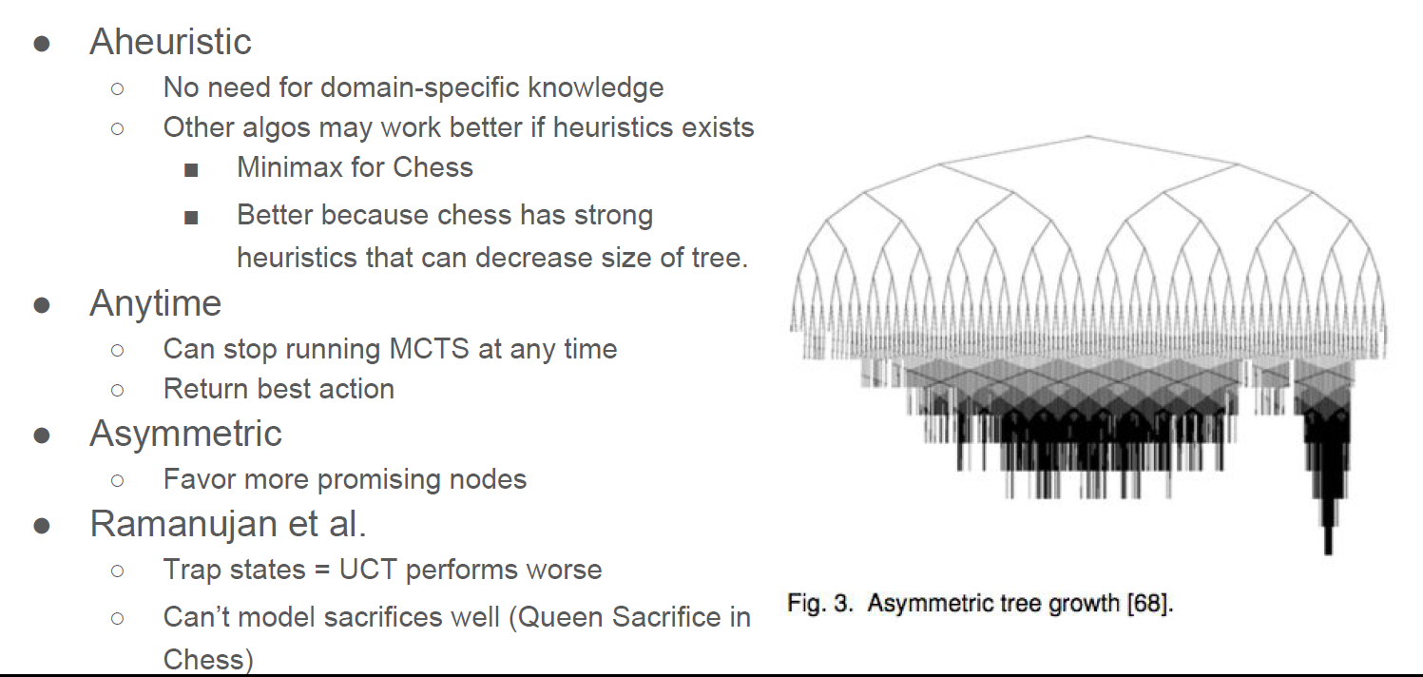
Advantages/Disadvantages of MCTS

Slide 16
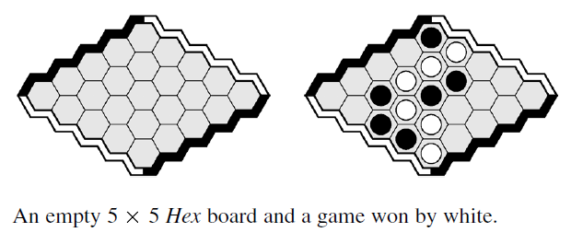
Game of Hex
Black & White alternate; player places single piece of their color on board/turn
Winner: forms a chain between two opposing board sides
First player has advantage (extra piece on board first)
Therefore, use swap rule

Slide 17
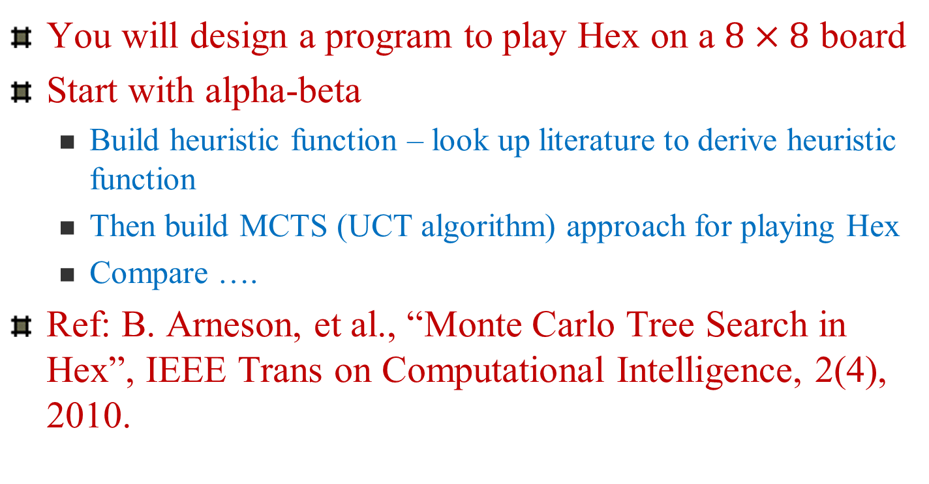
Assignment 2
You will design a program to play Hex on a $8×8$ board
Start with alpha-beta
Build heuristic function – look up literature to derive heuristic function
Then build MCTS (UCT algorithm) approach for playing Hex
Compare ….
Ref: B. Arneson, et al., “Monte Carlo Tree Search in Hex”, IEEE Trans on Computational Intelligence, 2(4), 2010.

Slide 18
Next Class
Next Topic:
Constraint Satisfaction Search

Slide 19
Policies
Policies are crucial for how MCTS operates
Tree policy
Used to determine how children are selected
Default policy
Used to determine how simulations are run (ex. randomized)
Result of simulation used to update values

